Slide 1
Introduction to shiny
Amit Arora

Slide 2
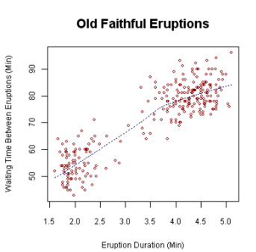
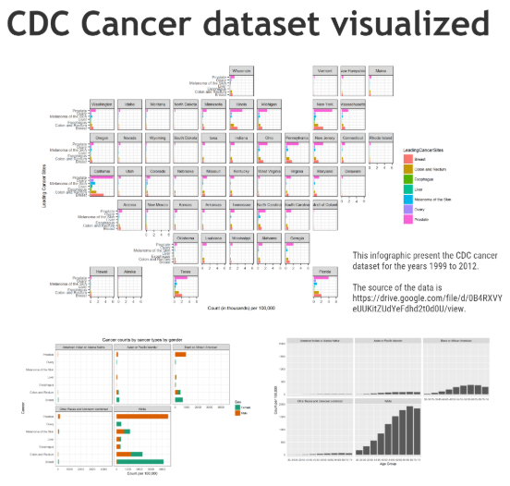
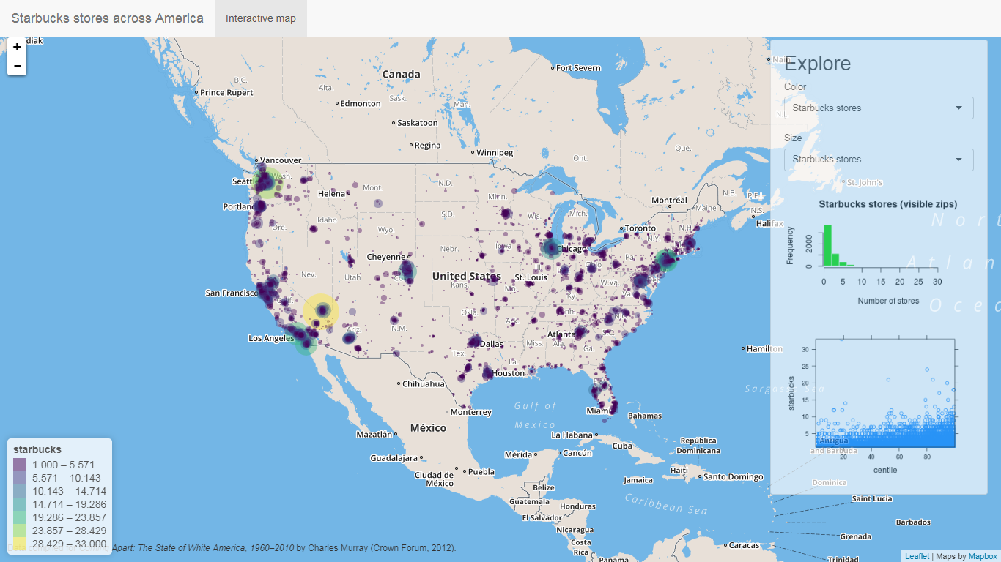
Why do we need shiny (or something like that)
Simple Plot
Infographic
Interactive Dashboard
Not only do we want interactivity, we want coordinated interactivity!!!

Slide 3
But we do have interactive plots…
Is it possible to make something that allows as much use interaction but does not require shiny?
For example what if a charting library which is anyway Javascript based (all of them are) can use some more Javascript to provide common UI features like buttons and sliders.
Answer is, it depends. For simple applications it is possible and it is probably the right choice there, but for anything as feature rich as typically shiny apps are, this wont work.
Plotly provides custom controls https://plot.ly/r/#controls, along with htmlwidgets and crosstalk we could make simple apps. Advantage is that these are completely client side which makes them faster. The output is an html file so you could email it, host it on a web server, but it does not require an R environment to live.
Shiny on the other hand addresses coordination between individual plots by allowing the programmer to define those interactions in R code.
What happens if the application needs to actually to download data from a data source (web server, database), what happens if the data needs to be periodically refreshed? We do need Shiny there.

Slide 4
Moving towards shiny…
Lets just say Shiny is an R package that allows us to build dashboards from super simple to super advanced with complex user interactions without having to know any javascript, css or html*
Follows a client (UI) server model where UI defines the user interface elements and server defines the backend server code except that both UI and Server code is just regular R code.

Slide 5
Shiny dashboards
HTML
Awareness
required
HTML5
Bootstrap
Shiny dashboard
Shiny runtime
Flex Dashboard
Very little HTML awareness required (Uses R Markdown)

Slide 6
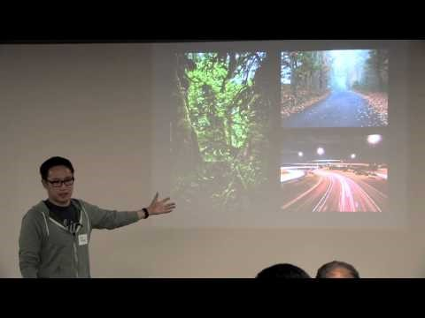
Absolutely must watch videos
https://www.rstudio.com/resources/videos/linking-html-widgets-with-crosstalk/
Introduction to Shiny from the person who designed it

Slide 7
Live code
We will do a simple Shiny code demo first and then a Flexdashboard demo.
Combine flexdashboard and Shiny.

Slide 8
Ideas we will need for making anything of practical use…
Some packages that we almost always would use in a Shiny dashboard
Package | Purpose | Functions
ggplot | General purpose charting library (non-interactive) | plotOutput, renderPlot
Plotly | General purpose charting library | plotlyOutput, renderPlotly
Highcharts | General purpose charting library | highchartOutput, renderHighchart https://github.com/rstudio/shiny-examples/tree/master/118-highcharter-births
Data Table (DT) | Display nicely formatted, searchable, interactive tables | renderDT, DTOutput https://shiny.rstudio.com/gallery/basic-datatable.html
Dygraphs, sunburst | Timeseries | renderDygraph, dygraphOutput https://rstudio.github.io/dygraphs/shiny.html

Slide 9
Ideas we will need for making anything of practical use…
Reactive expressions, Observable events
(see this link https://shiny.rstudio.com/tutorial/written-tutorial/lesson6/)
OutputProxy
(see https://www.rdocumentation.org/packages/leaflet/versions/2.0.2/topics/leafletProxy and https://plot.ly/r/plotlyproxy/ for examples)

